Slide 1
Instant Message

Slide 2
Outline
Instant Message Function
Architecture
XMPP Protocol

Slide 3
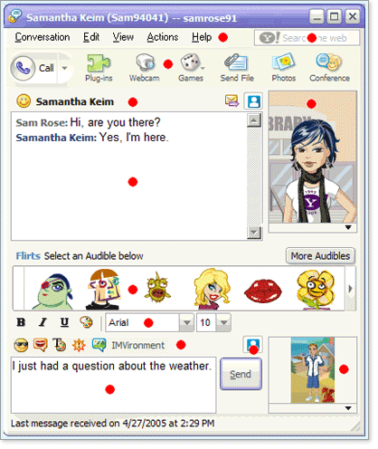
Instant Message Function

Slide 4
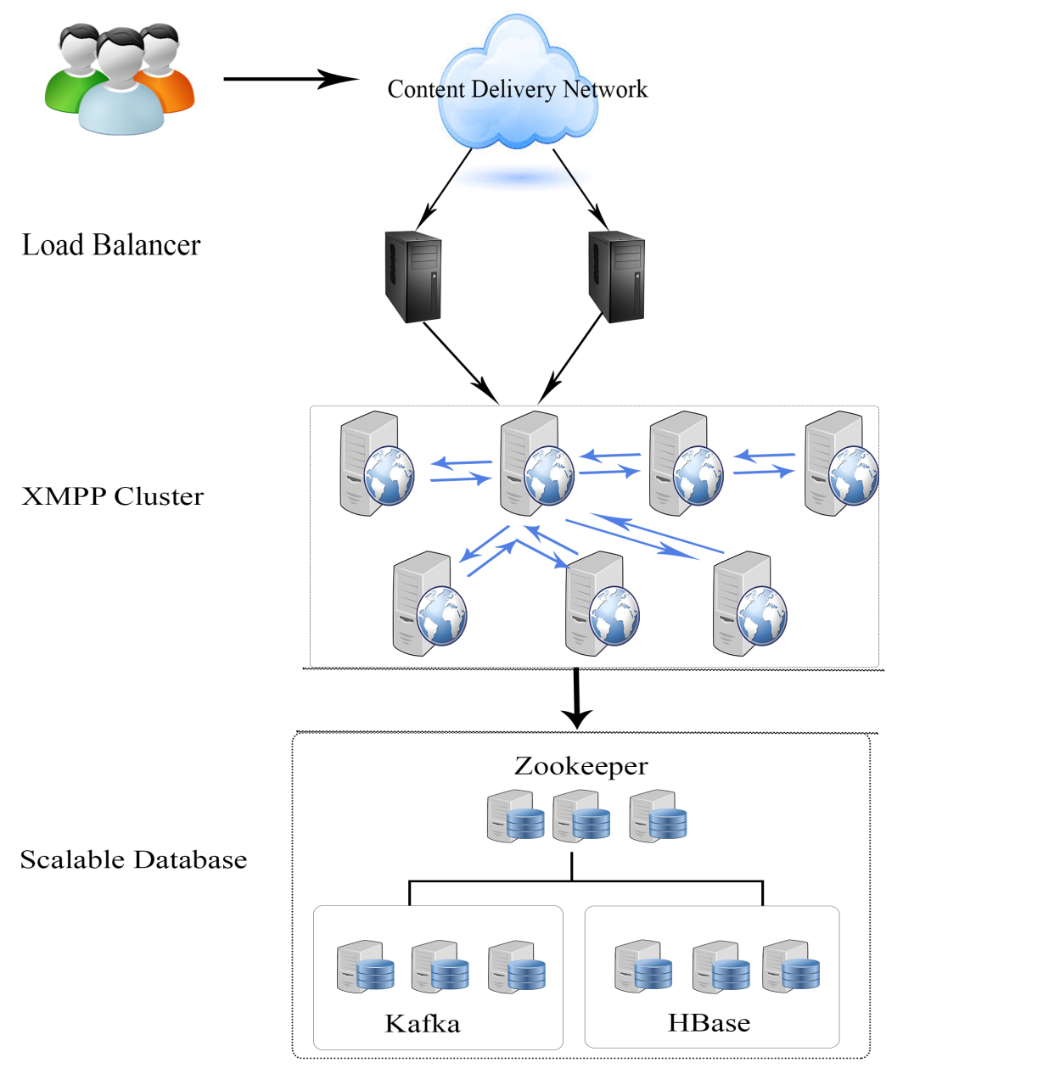

Architecture
Another data center
A data center

Slide 5
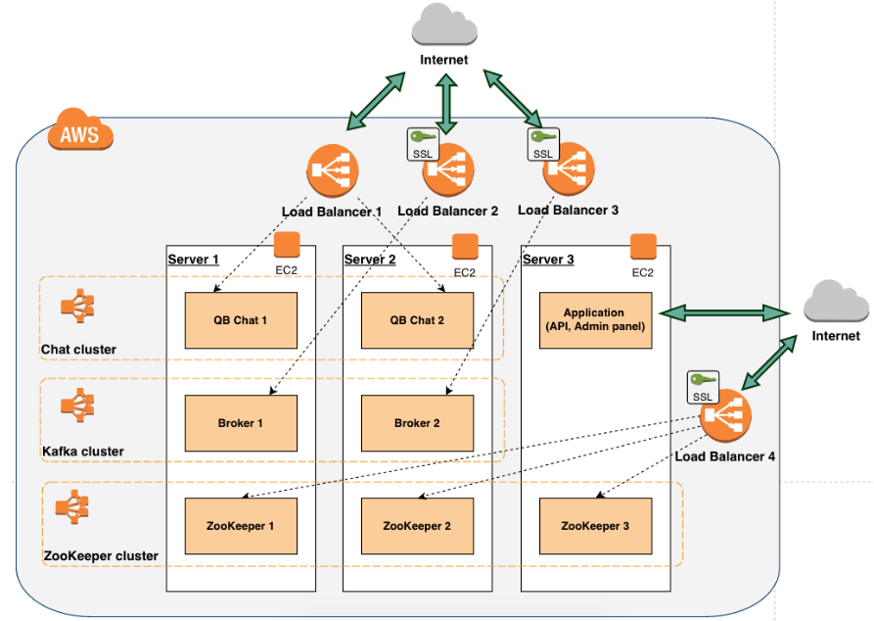
The company that similarly use this architecture
http://quickblox.com/blog/kafka-xmpp-chat-ssl-clustering-married-together/

Slide 6
Term
Content delivery network (CDN)
http://en.wikipedia.org/wiki/Content_delivery_network
Load balancer
http://en.wikipedia.org/wiki/Load_balancing_%28computing%29
Extensible Messaging and Presence Protocol (XMPP)
http://en.wikipedia.org/wiki/XMPP
Zookeeper
http://zookeeper.apache.org/
HBase
http://hbase.apache.org/
Kafka
http://kafka.apache.org/

Slide 7
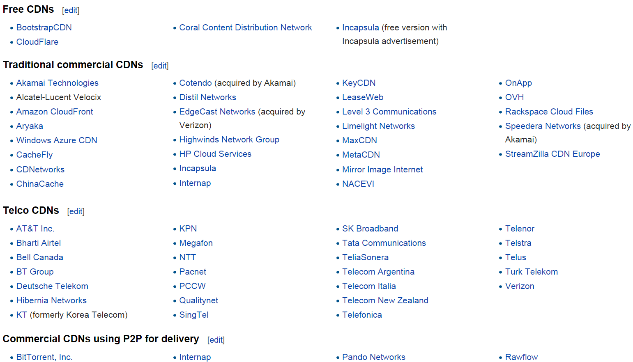
CDN Provider

Slide 8


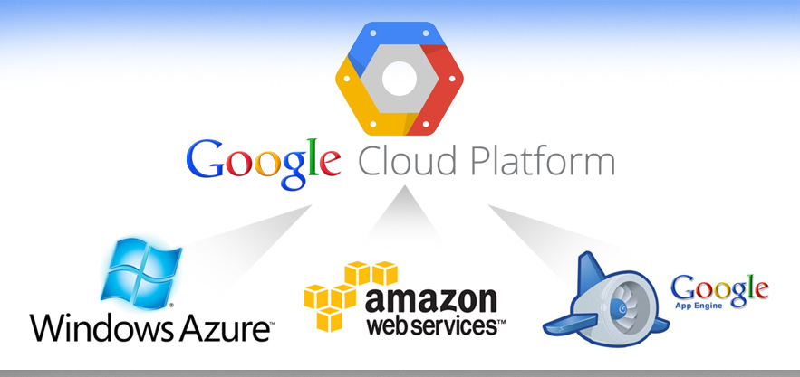
Cloud Computing Service

Slide 9

Extensible Messaging and Presence Protocol (XMPP) http://xmpp.org/
Open standard communications protocol for message-oriented based on XML
Originally named Jabber, and was developed by the Jabber open-source community in 1999 for near real-time, instant messaging (IM), presence information, and contact list maintenance, VoIP, video, file transfer, gaming
The Internet Engineering Task Force (IETF) formed an XMPP working group in 2002 to formalize the core protocols as an IETF instant messaging and presence technology
The XMPP Standards Foundation (formerly the Jabber Software Foundation) is active in developing open XMPP extensions

Slide 10
Messenger support XMPP
Google, Google Talk, 2005
Facebook, Facebook Messenger, 2010
Wechat, 2011

Slide 11
XMPP Server List
http://xmpp.org/xmpp-software/servers

Slide 12
Why choose Openfire?
http://stackoverflow.com/questions/13330106/open-source-xmpp-server-for-im
Java-Based
Open source, Apache License2.0
Many-Plugin
Web Admin Interface
Documentation
http://www.igniterealtime.org/index.jsp

Slide 13
Demo
Deploy 1 Load balance server
Deploy 3 Openfire XMPP server
Because Openfire DB use RDBMS (not scalable out), use Postgresql

Slide 14
Thanks for your attention

